Slide 1
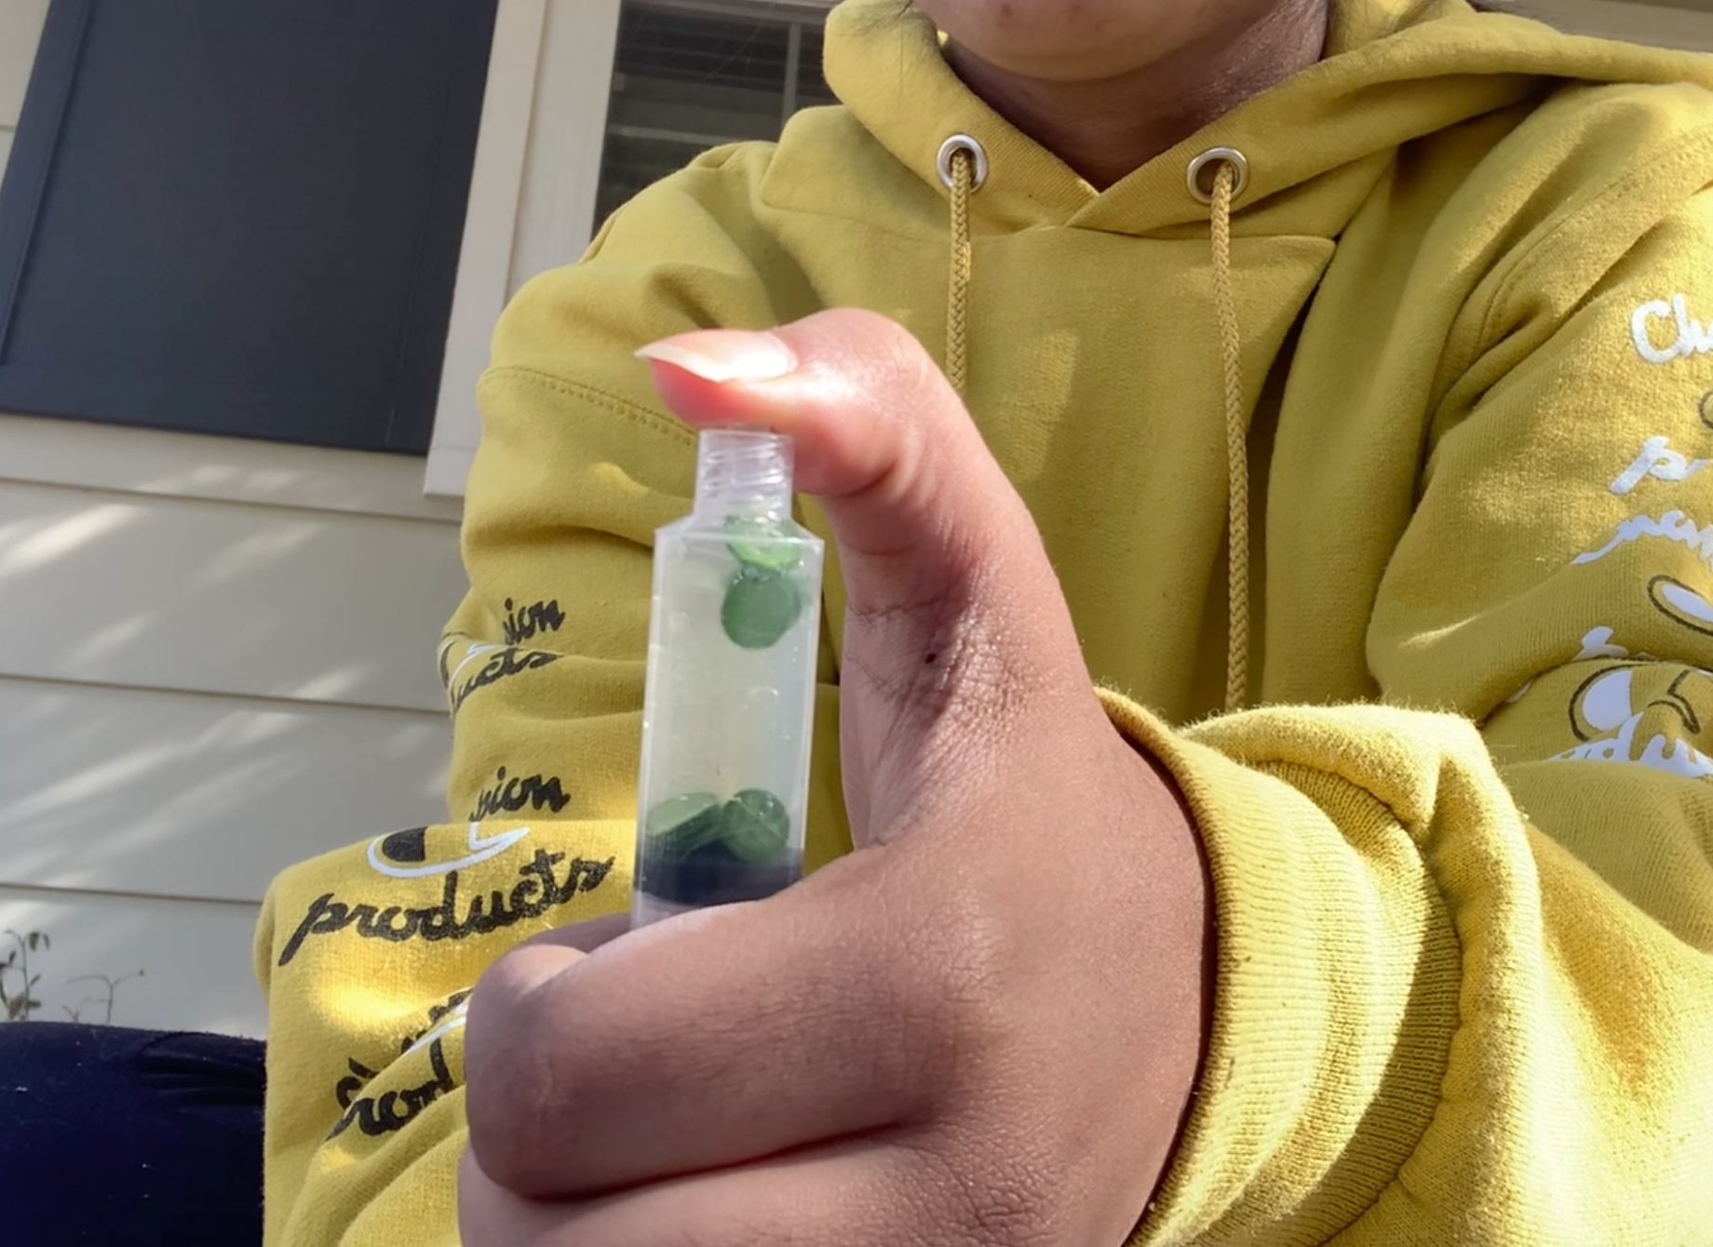
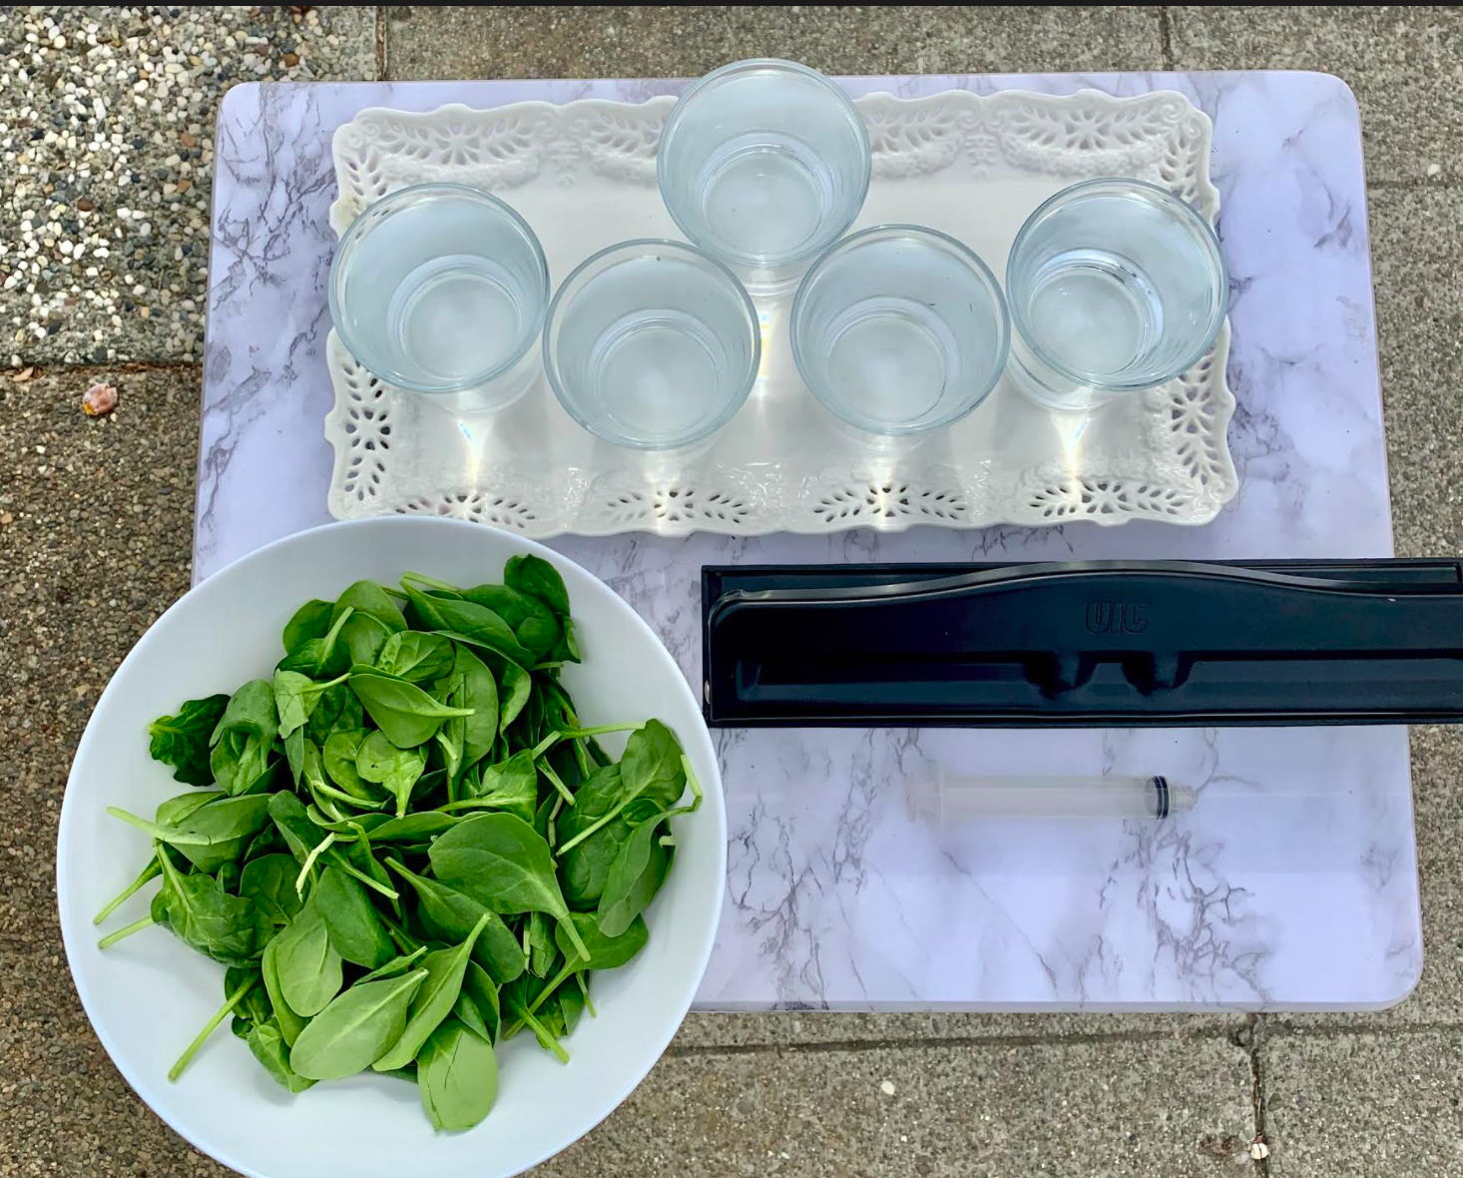
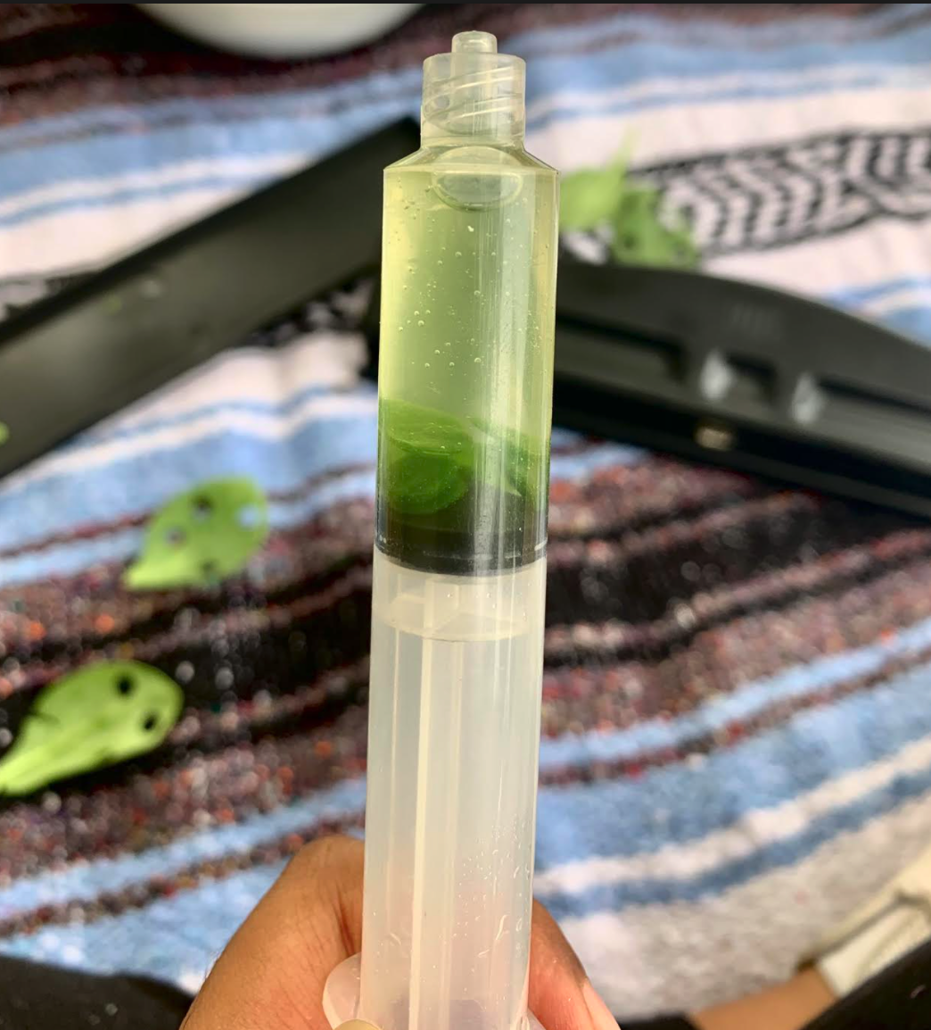
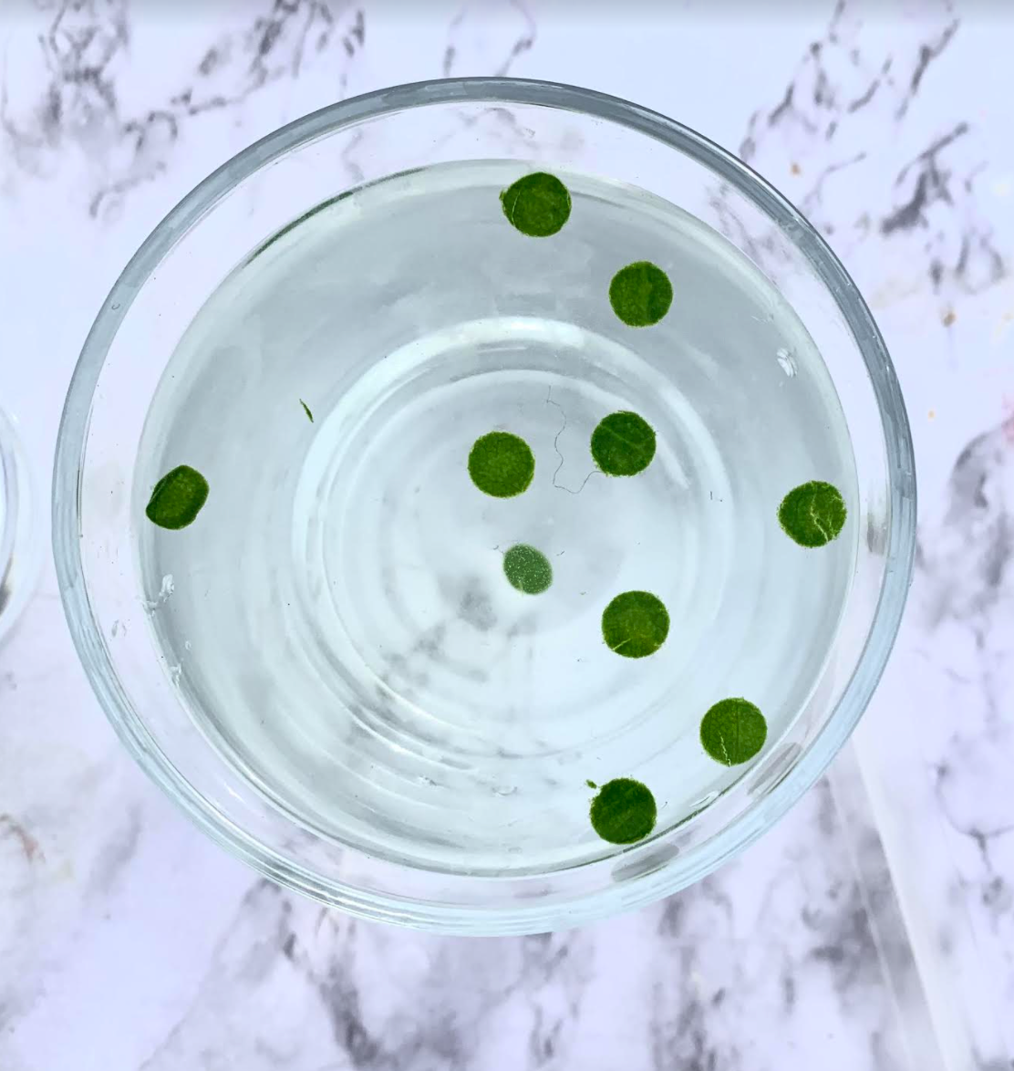
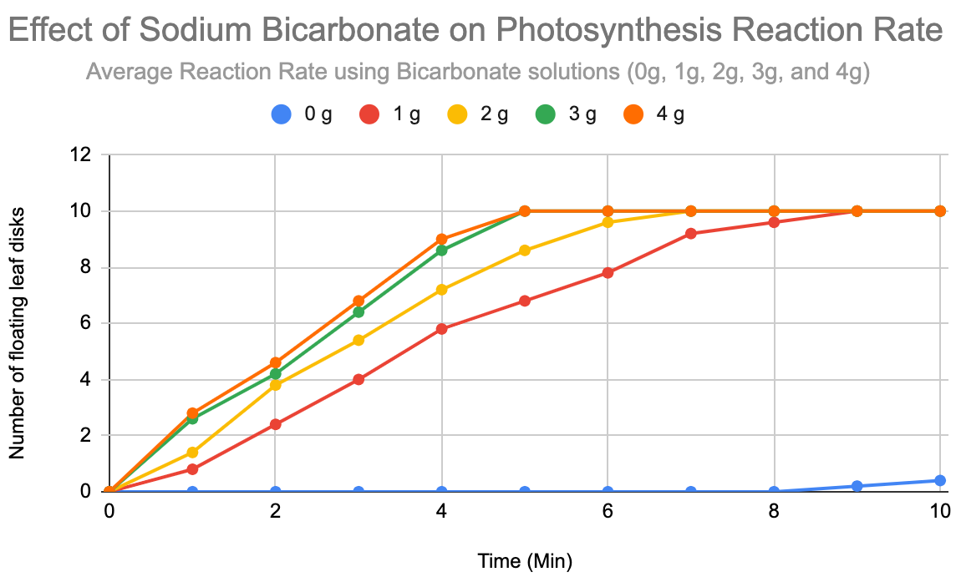
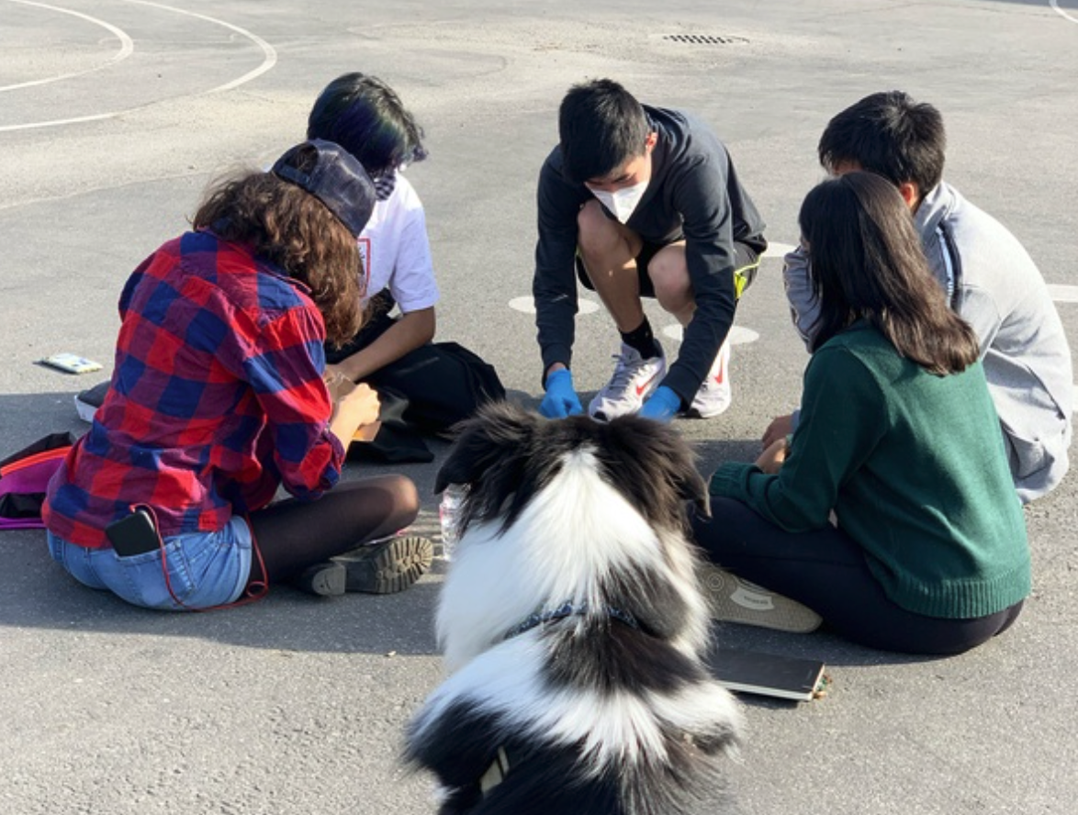
The Effect of Substrate Concentration on the Rate of Photosynthesis
William Chen, Aroshi Ghosh, Muskaan Grewal, Anoushka Shah, Ryan Sohn
AP Biology Period 6
Abstract
Variables
Conclusion
In this experiment, we used sodium bicarbonate and disks of spinach leaves to test whether the rate at which photosynthesis occurs could be sped up through the addition of more carbon dioxide (found in the sodium bicarbonate). Previous research and runs of this experiment have shown that adding disks of leaves to a solution of water and sodium bicarbonate does indeed allow the leaf to photosynthesize. For our tests, we created a vacuum using a syringe to make the leaf disks sink before putting them into a glass of a bicarbonate solution exposed to sunlight to see how long it would take the leaves to photosynthesize, creating oxygen and causing them to float. To test our hypothesis that an increased substrate concentration would also increase the rate of photosynthesis, we ran this experiment with multiple trials of different bicarbonate concentrations, ranging from zero to four grams. Our results supported our hypothesis, suggesting that a photosynthesizing plant in an environment with higher carbon dioxide levels would photosynthesize quicker.
Independent Variable: Our independent variable is varying levels of substrate concentration. We added 0g, 1g, 2g, 3g, and 4g of sodium bicarbonate to 5 glasses each filled with 175g of water.
Dependent Variable: Our dependent variable is the number of leaves that have floated to the top after a specific amount of time and substrate concentration.
Our results do support our original hypothesis, as the rate of photosynthesis grew significantly quicker with the addition of more sodium bicarbonate, our substrate. In our hypothesis, we also predicted that the rate of photosynthesis would max out at a certain point due to the finite amount of chloroplasts in the leaves. This is supported by the data from our trials with 3 grams and 4 grams of substrate, which had very similar results. We could further reinforce this in future experiments by testing for the rate of photosynthesis with higher amounts of substrate (5 g, 6 g, etc.).
Picture of setup
Reflection
Data
Due to COVID-19 restrictions, we were unable to meet up as much as we might have liked. However, we were still able to work together through zoom and communicate through text. It also took us more attempts than we initially anticipated to complete the experiment. If we had coordinated our efforts to finish the experiment earlier, we would have had more time to finish the poster and video.
In future experiments, we would like to include higher concentrations of substrate (5 g, 6g, etc) to solidify our theory that there are a limited number of active sites and at a certain point, the reaction rate stops increasing. Additionally, as we did our experiment during late fall when sunlight is not as bright, we would like to attempt this experiment again but in the Summer when sunlight is brightest. We believe that this will allow us to have more accurate results as there will be less variability in the light source.
The Number of Leaves (on average) that have floated
Time (Min) | 0g | 1g | 2g | 3g | 4g
0 | 0 | 0 | 0 | 0 | 0
1 | 0 | 0.8 | 1.4 | 2.6 | 2.8
2 | 0 | 2.4 | 3.8 | 4.2 | 4.6
3 | 0 | 4 | 5.4 | 6.4 | 6.8
4 | 0 | 5.8 | 7.2 | 8.6 | 9
5 | 0 | 6.8 | 8.6 | 10 | 10
6 | 0 | 7.8 | 9.6 | 10 | 10
7 | 0 | 9.2 | 10 | 10 | 10
8 | 0 | 9.6 | 10 | 10 | 10
9 | 0.2 | 10 | 10 | 10 | 10
10 | 0.4 | 10 | 10 | 10 | 10
Background Information
Photosynthesis is one of the major processes for plants and it converts water, carbon dioxide, and light into glucose and oxygen. This occurs inside the chloroplasts within plant cells. In order to simulate photosynthesis in a controlled environment, we need living plant cells (our spinach leaf disks), carbon dioxide (found in sodium bicarbonate), water, and a light source.
Materials and Procedure
Materials:
250 Spinach Leaf Disks (10 per trial * 5 substrates * 5 repetitions of the experiment)
Water (175 grams for each trial)
Sodium Bicarbonate/Baking Soda (our substrate levels were 0g, 1g, 2g, 3g, 4g)
Light Source
Liquid dish soap
Syringe with good suction (no needle)
Clear cups
Procedure:
Create each bicarbonate solution in the clear cups by mixing 175 milliliters of water with the respective sodium bicarbonate substrate amount (0 grams, 1 gram, 2 grams, 3 grams, or 4 grams). Add a drop of liquid dish soap to help the solution enter the leaves more easily.
Cut out 10 disks of spinach leaves (avoiding veins or dead regions) and place in empty syringe. Suck in a small amount of the bicarbonate solution (about half of the syringe). Form a vacuum by blocking the tip of the syringe and pulling back until you feel pressure. Release the syringe and check if all the disks have sunk. Then, dump leaves and solution back into clear glass.
Mark down how many leaves float after each minute until all have risen. Make sure to stir occasionally to ensure that leaves do not stick together.
Question
How do varying levels of substrate concentration (carbon dioxide found in sodium bicarbonate) affect the rate at which spinach leaves can photosynthesize?
Hypothesis
If the amount of substrate changes, then the rate of Photosynthesis will change. We expect that the more substrate added, the fast the rate of photosynthesis will be since there is more substrate available to the chloroplasts, allowing them to be more efficient. However, we also foresee that at a certain level of substrate concentration, the rate of photosynthesis will stop changing as there is a limited amount of chloroplasts in the leaves.
Throughout the experiment, we collected 250 data points (5 trials of 10 disks per substrate). We then took the average number of leaves floating at each minute for all the trials for each substrate. .

Slide 2
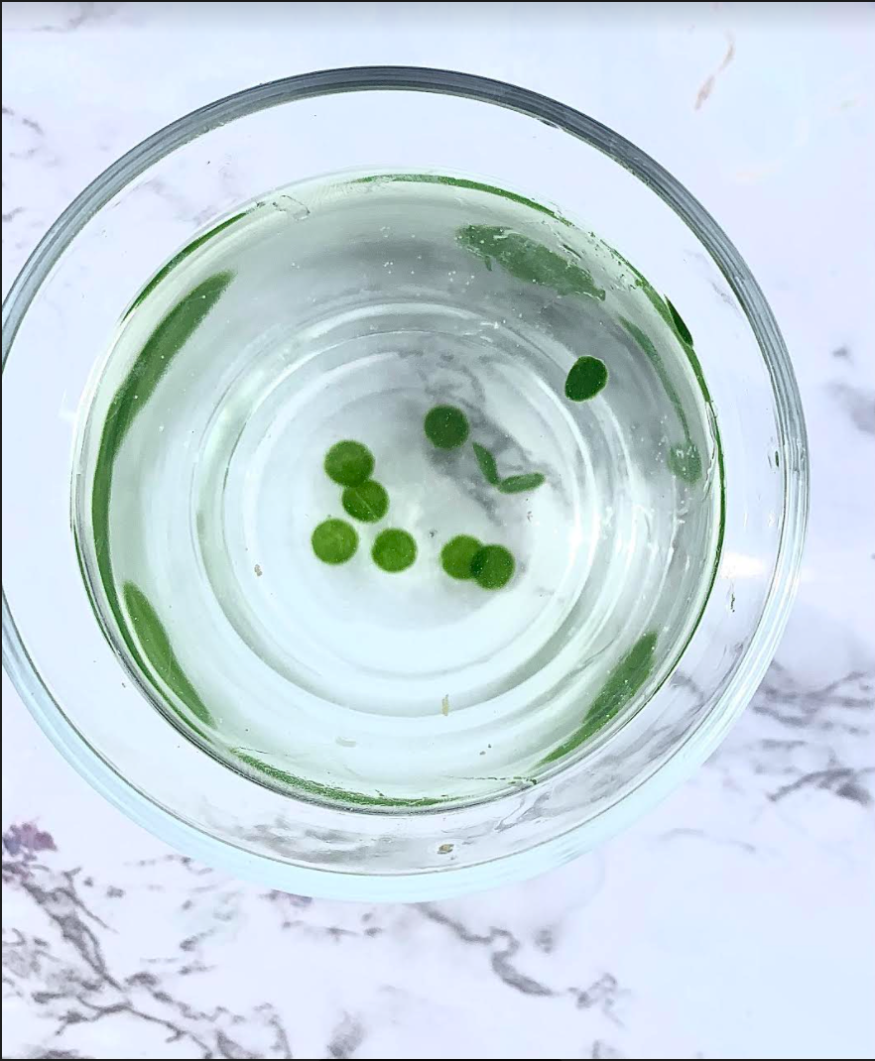
Abstract
Test the effect of substrate concentration on Photosynthesis
Simulate photosynthesis
Successful experiment
Notes:
Aroshi - In this experiment, we used sodium bicarbonate and disks of spinach leaves to test whether the rate at which photosynthesis occurs could be sped up through the addition of more carbon dioxide (found in the sodium bicarbonate). Previous research and runs of this experiment have shown that adding disks of leaves to a solution of water and sodium bicarbonate does indeed allow the leaf to photosynthesize. For our tests, we created a vacuum using a syringe to make the leaf disks sink before putting them into a glass of a bicarbonate solution exposed to sunlight to see how long it would take the leaves to photosynthesize, creating oxygen and causing them to float. To test our hypothesis that an increased substrate concentration would also increase the rate of photosynthesis, we ran this experiment with multiple trials of different bicarbonate concentrations, ranging from zero to four grams. Our results supported our hypothesis, suggesting that a photosynthesizing plant in an environment with higher carbon dioxide levels would photosynthesize quicker.

Slide 3
Background Information
Photosynthesis: major process for plants to gain energy
Simulate photosynthesis in a controlled environment
Question: How do varying levels of substrate concentration (Carbon Dioxide) affect the rate at which spinach leaves can photosynthesize?
Notes:
William - Photosynthesis is one of the major processes for plants and it converts water, carbon dioxide, and light into glucose and oxygen. This occurs inside the chloroplasts within plant cells. In order to simulate photosynthesis in a controlled environment, we need living plant cells (our spinach leaf disks), carbon dioxide (found in sodium bicarbonate), water, and a light source. Once we are able to simulate photosynthesis, we are able to zero in on specific variables to see how they affect photosynthesis. For this lab, we focused on how varying levels of substrate concentration affects the rate at which spinach leaves can photosynthesize.

Slide 4
Hypothesis
If the amount of substrate changes, then the rate of Photosynthesis will change
At a certain point, even as the substrate increases, the rate of reaction will remain the same
Notes:
Anoushka - Our Hypothesis If the amount of substrate changes, then the rate of Photosynthesis will change. We expect that the more substrate added, the fast the rate of photosynthesis will be since there is more substrate available to the chloroplasts, allowing them to be more efficient. However, we also foresee that at a certain level of substrate concentration, the rate of photosynthesis will stop changing as there is a limited amount of chloroplasts in the leaves.

Slide 5
Design
Independent Variable: Substrate amount (0g, 1g, 2g, 3g, 4g)
Dependent Variable: Number of leaves floating after each minute
5 repetitions x 10 disks x 5 substrates = 250 datapoints
Notes:
Ryan - Our independent variable is varying levels of substrate concentration. We added 0g, 1g, 2g, 3g, and 4g of sodium bicarbonate to 5 glasses each filled with 175g of water. Our dependent variable is the number of leaves that have floated to the top after a specific amount of time. We repeated this experiment 5 times giving us 50 leaves for each of the 5 substrates. We started by creating each bicarbonate solution in the clear cups and adding a drop of liquid dish soap to help the bicarbonate solution enter the leaves more easily. Then, we cut out 10 disks of spinach leaves (avoiding veins or dead regions) and placed them in an empty syringe. We then took some of the liquid and created a vacuum in the syringe to get the oxygen out of the leaves. Finally, we dumped leaves and solution back into clear glass, mark down how many leaves have floated after each minute.

Slide 6
Data
The Number of Leaves (on average) that have floated for each substrate amount
Time (Min) | 0g | 1g | 2g | 3g | 4g
0 | 0 | 0 | 0 | 0 | 0
1 | 0 | 0.8 | 1.4 | 2.6 | 2.8
2 | 0 | 2.4 | 3.8 | 4.2 | 4.6
3 | 0 | 4 | 5.4 | 6.4 | 6.8
4 | 0 | 5.8 | 7.2 | 8.6 | 9
5 | 0 | 6.8 | 8.6 | 10 | 10
6 | 0 | 7.8 | 9.6 | 10 | 10
7 | 0 | 9.2 | 10 | 10 | 10
8 | 0 | 9.6 | 10 | 10 | 10
9 | 0.2 | 10 | 10 | 10 | 10
10 | 0.4 | 10 | 10 | 10 | 10
Notes:
Muskaan - Throughout the experiment, we collected 250 data points (5 trials of 10 disks per substrate). We then took the average number of leaves floating at each minute for all the trials for each substrate as shown in the table. As we can see in the graph, 0 g of substrate didn’t allow for Photosynthesis since there was no carbon dioxide present. As we increased our substrate amount, the rate of reaction became faster which is shown in the steeper slopes on the 3g and 4g substrate lines. However, 3g and 4g substrate amounts yielded similar results. This is probably because there are less active sites available compared to the amount of substrates.

Slide 7
Conclusion/Reflection
Supports hypothesis
add larger substrate amounts in future experiments
COVID-19 restrictions
many failed attempts
Notes:
Aroshi - Our results do support our original hypothesis, as the rate of photosynthesis grew significantly quicker with the addition of more sodium bicarbonate, our substrate. In our hypothesis, we also predicted that the rate of photosynthesis would max out at a certain point due to the finite amount of active sites in the leaves. This is supported by the data from our trials with 3 grams and 4 grams of substrate, which had very similar results. We could further reinforce this in future experiments by testing for the rate of photosynthesis with higher amounts of substrate (5 g, 6 g, etc.).
William - Due to COVID-19 restrictions, we were unable to meet up as much as we might have liked. However, we were still able to work together through zoom and communicate through text. It also took us more attempts than we initially anticipated to complete the experiment. If we had coordinated our efforts to finish the experiment earlier, we would have had more time to finish the poster and video.

Slide 8
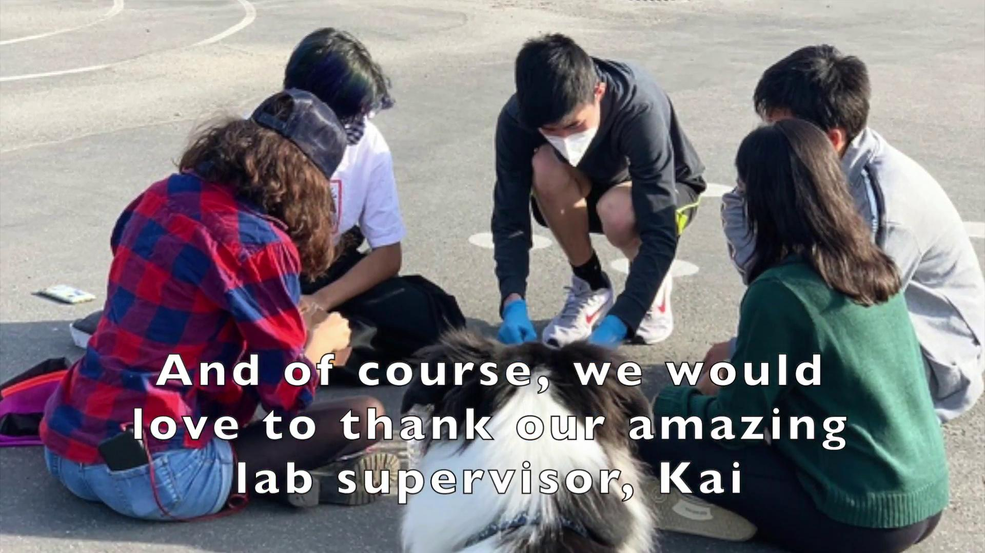

Slide 9
The Effect of Substrate Concentration on the Rate of Photosynthesis
William Chen, Aroshi Ghosh, Muskaan Grewal, Anoushka Shah, Ryan Sohn
AP Biology Period 6
Abstract
Variables
Conclusion
In this experiment, we used sodium bicarbonate and disks of spinach leaves to test whether the rate at which photosynthesis occurs could be sped up through the addition of more carbon dioxide (found in the sodium bicarbonate). Previous research and runs of this experiment have shown that adding disks of leaves to a solution of water and sodium bicarbonate does indeed allow the leaf to photosynthesize. For our tests, we created a vacuum using a syringe to make the leaf disks sink before putting them into a glass of a bicarbonate solution exposed to sunlight to see how long it would take the leaves to photosynthesize, creating oxygen and causing them to float. To test our hypothesis that an increased substrate concentration would also increase the rate of photosynthesis, we ran this experiment with multiple trials of different bicarbonate concentrations, ranging from zero to four grams. Our results supported our hypothesis, suggesting that a photosynthesizing plant in an environment with higher carbon dioxide levels would photosynthesize quicker.
Independent Variable: Our independent variable is varying levels of substrate concentration. We added 0g, 1g, 2g, 3g, and 4g of sodium bicarbonate to 5 glasses each filled with 175g of water.
Dependent Variable: Our dependent variable is the number of leaves that have floated to the top after a specific amount of time and substrate concentration.
Our results do support our original hypothesis, as the rate of photosynthesis grew significantly quicker with the addition of more sodium bicarbonate, our substrate. In our hypothesis, we also predicted that the rate of photosynthesis would max out at a certain point due to the finite amount of chloroplasts in the leaves. This is supported by the data from our trials with 3 grams and 4 grams of substrate, which had very similar results. We could further reinforce this in future experiments by testing for the rate of photosynthesis with higher amounts of substrate (5 g, 6 g, etc.).
Picture of setup
Reflection
Data
Due to COVID-19 restrictions, we were unable to meet up as much as we might have liked. However, we were still able to work together through zoom and communicate through text. It also took us more attempts than we initially anticipated to complete the experiment. If we had coordinated our efforts to finish the experiment earlier, we would have had more time to finish the poster and video.
In future experiments, we would like to include higher concentrations of substrate (5 g, 6g, etc) to solidify our theory that there are a limited number of active sites and at a certain point, the reaction rate stops increasing. Additionally, as we did our experiment during late fall when sunlight is not as bright, we would like to attempt this experiment again but in the Summer when sunlight is brightest. We believe that this will allow us to have more accurate results as there will be less variability in the light source.
The Number of Leaves (on average) that have floated
Time (Min) | 0g | 1g | 2g | 3g | 4g
0 | 0 | 0 | 0 | 0 | 0
1 | 0 | 0.8 | 1.4 | 2.6 | 2.8
2 | 0 | 2.4 | 3.8 | 4.2 | 4.6
3 | 0 | 4 | 5.4 | 6.4 | 6.8
4 | 0 | 5.8 | 7.2 | 8.6 | 9
5 | 0 | 6.8 | 8.6 | 10 | 10
6 | 0 | 7.8 | 9.6 | 10 | 10
7 | 0 | 9.2 | 10 | 10 | 10
8 | 0 | 9.6 | 10 | 10 | 10
9 | 0.2 | 10 | 10 | 10 | 10
10 | 0.4 | 10 | 10 | 10 | 10
Background Information
Photosynthesis is one of the major processes for plants and it converts water, carbon dioxide, and light into glucose and oxygen. This occurs inside the chloroplasts within plant cells. In order to simulate photosynthesis in a controlled environment, we need living plant cells (our spinach leaf disks), carbon dioxide (found in sodium bicarbonate), water, and a light source.
Materials and Procedure
Materials:
250 Spinach Leaf Disks (10 per trial * 5 substrates * 5 repetitions of the experiment)
Water (175 grams for each trial)
Sodium Bicarbonate/Baking Soda (our substrate levels were 0g, 1g, 2g, 3g, 4g)
Light Source
Liquid dish soap
Syringe with good suction (no needle)
Clear cups
Procedure:
Create each bicarbonate solution in the clear cups by mixing 175 milliliters of water with the respective sodium bicarbonate substrate amount (0 grams, 1 gram, 2 grams, 3 grams, or 4 grams). Add a drop of liquid dish soap to help the solution enter the leaves more easily.
Cut out 10 disks of spinach leaves (avoiding veins or dead regions) and place in empty syringe. Suck in a small amount of the bicarbonate solution (about half of the syringe). Form a vacuum by blocking the tip of the syringe and pulling back until you feel pressure. Release the syringe and check if all the disks have sunk. Then, dump leaves and solution back into clear glass.
Mark down how many leaves float after each minute until all have risen. Make sure to stir occasionally to ensure that leaves do not stick together.
Question
How do varying levels of substrate concentration (carbon dioxide found in sodium bicarbonate) affect the rate at which spinach leaves can photosynthesize?
Hypothesis
If the amount of substrate changes, then the rate of Photosynthesis will change. We expect that the more substrate added, the fast the rate of photosynthesis will be since there is more substrate available to the chloroplasts, allowing them to be more efficient. However, we also foresee that at a certain level of substrate concentration, the rate of photosynthesis will stop changing as there is a limited amount of chloroplasts in the leaves.
Throughout the experiment, we collected 250 data points (5 trials of 10 disks per substrate). We then took the average number of leaves floating at each minute for all the trials for each substrate. .

